Slide 1
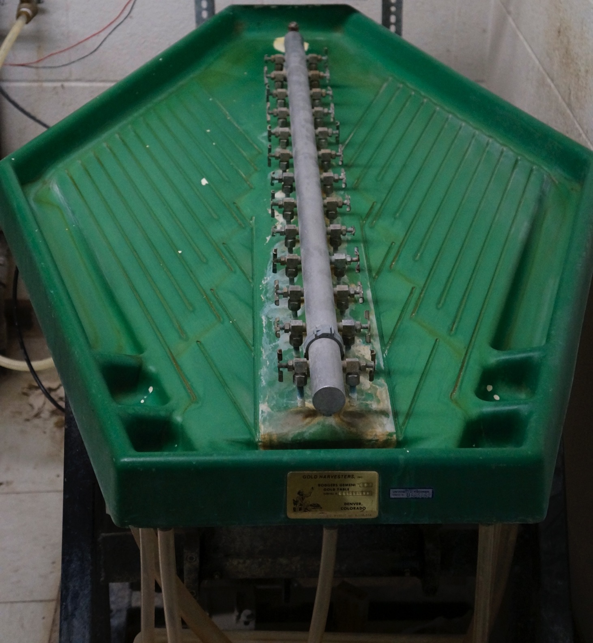
Gold Table

Slide 2
Overview
Water carries the crushed sample over the table top both disaggregating clumped material and providing a rough density separation.
Denser material will travel down the center of the table while other material will flow to the sides.

Slide 3
Gold Table
Set up
Ensure all drain tubing is connected
Clean any stray material off the tabletop
The flow from each jet should be adjusted first to produce a smooth surface flow.

Slide 4
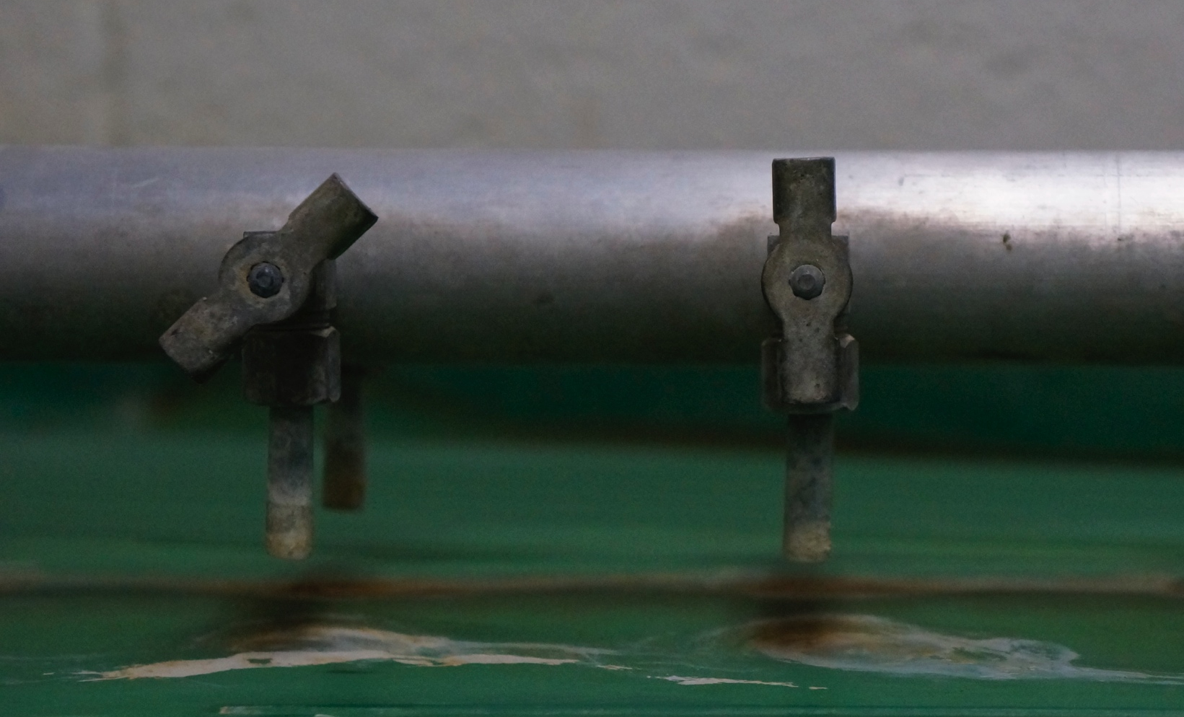
Gold Table
Set up
The first, largest jet should be set to quickly spread the sample, but not sweep everything to the outside of the table.
Adjust the smaller jets such the the upper edge of the sample flows to the inner channel while other material continues in the outside channels.

Slide 5
Gold Table
Set up
Position a bag in a plastic tub under each outlet.
Depending on the application, some side outlets can be combined to a single bag.
Water should continually flow out of each bag (into the larger drain box) while the sample sinks to the bottom.
Ensure that the center bag does not cover the outlet of the drain box.
The drain tube should run to the floor drain.

Slide 6
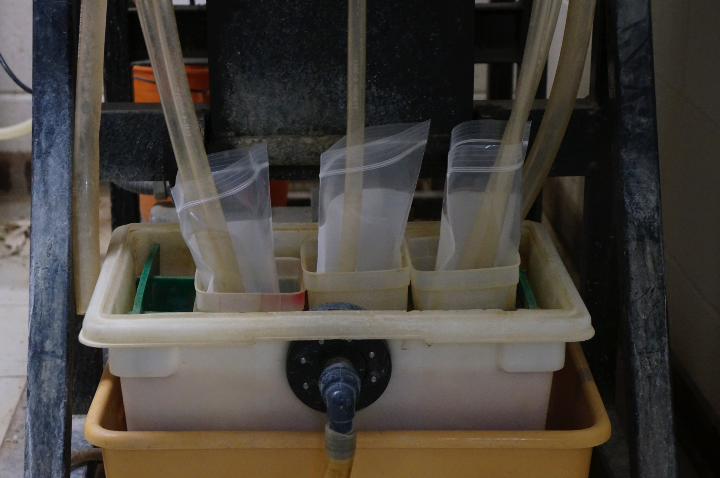
Gold Table
Sample Collection set up
Most dense
material
Less dense
Less dense
To floor drain

Slide 7
Gold Table
Running a Sample
Sample is introduced from the vibrating shoot at the head of the table.
The feed rate will vary with the amount of material remaining in the shoot and should be monitored to ensure the table is not overloaded
Water pressure from the wall is not consistent and thus the jets should be monitored and adjusted as needed.

Slide 8
Gold Table
Clean up
Clean any stray material from the tabletop
Pour water from the drain box down the drain, water containing significant solid material should be dumped in the sand-disposal container so it does not clog the plumbing
Decant the water from the samples and dry in the oven.

